Slide 1

PLP Learning

Slide 2

Installation & Navigation of Visual Studio Code (VS Code)

Slide 3
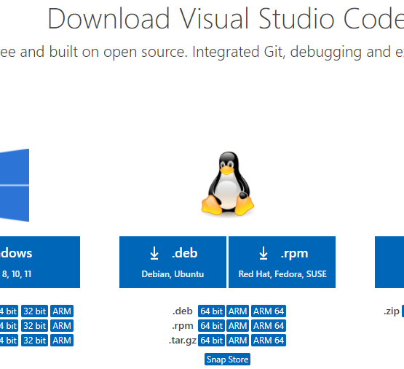
Step 1.
Visit the official website (Download Visual Studio Code - Mac, Linux, Windows) of the Visual Studio Code using any web browser like Google Chrome, Microsoft Edge, etc.

Slide 4
1.1
Press the “Download for Windows” button on the website to start the download of the Visual Studio Code Application.

Slide 5
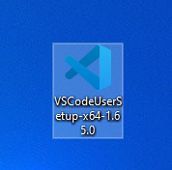
1.2
When the download finishes, then the Visual Studio Code Icon appears in the downloads folder.

Slide 6

Step 2. First Time Set-up

Slide 7
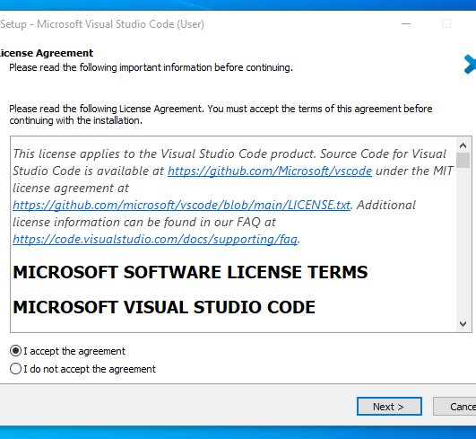
Step 2.
Click on the Installer icon to start the installation process of the Visual Studio Code.
After the Installer opens, it will ask you to accept the terms and conditions of the Visual Studio Code. Click on ”I accept the agreement” and then click the ”Next button”.

Slide 8
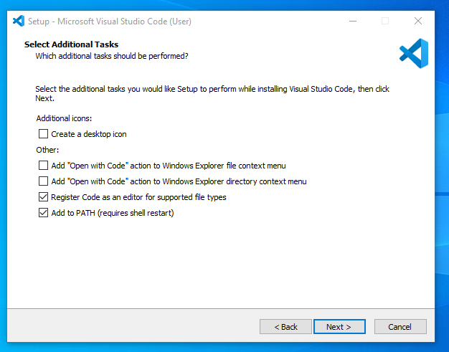
2.1
Choose the location data for running the Visual Studio Code. It will then ask you to browse the location. Then click on the Next button.

Slide 9
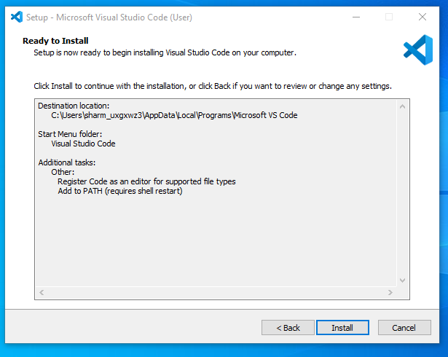
2.2
Then it will ask to begin the installation setup. Click on the Install button.

Slide 10
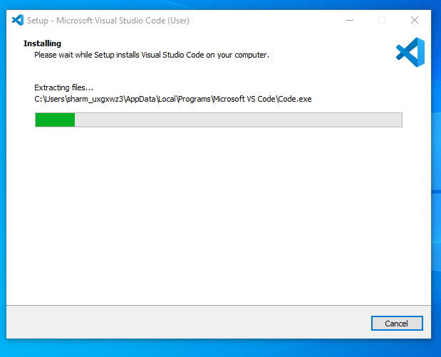
2.3
After clicking on Install, it will take about 1 minute to install the Visual Studio Code on your device.

Slide 11
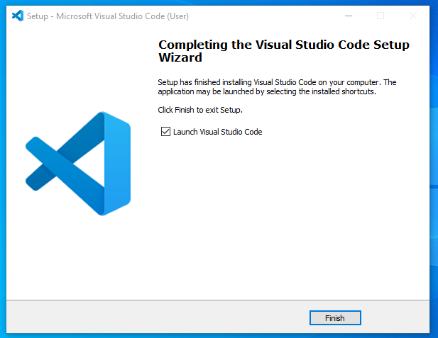
2.4
After the Installation setup for Visual Studio Code is finished, it will show a window like this below. Tick the “Launch Visual Studio Code” checkbox and then click Next.

Slide 12
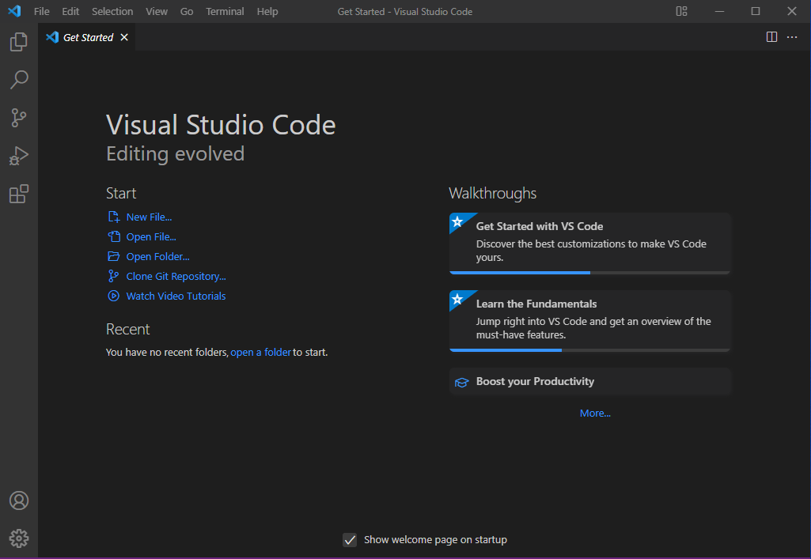
2.5
After the previous step, the Visual Studio Code window opens successfully. Now you can create a new file in the Visual Studio Code window and choose a language of yours to begin your programming journey

Slide 13
Click on the Link to set-up VS Code environment.
https://youtu.be/I5Ykdq5WZoE?si=60XiosyB6PGluMcM

Slide 14

Step 3. User Interface Overview

Slide 15
User Interface Overview
Editor Area: This is the primary space where you edit your files. You can open multiple editors side by side, both vertically and horizontally¹.
Side Bar: The Side Bar contains various views, such as the Explorer, which assists you while working on your project. It provides quick access to files, folders, and extensions¹.
Status Bar: Located at the bottom, the Status Bar displays information about the opened project and the files you’re editing. It may show details like line and column numbers, Git status, and language mode¹.
Activity Bar: Positioned on the far left, the Activity Bar lets you switch between different views. It provides context-specific indicators, such as the number of outgoing changes when Git is enabled¹.
Click the for more information: https://code.visualstudio.com/docs/getstarted/userinterface

Slide 16
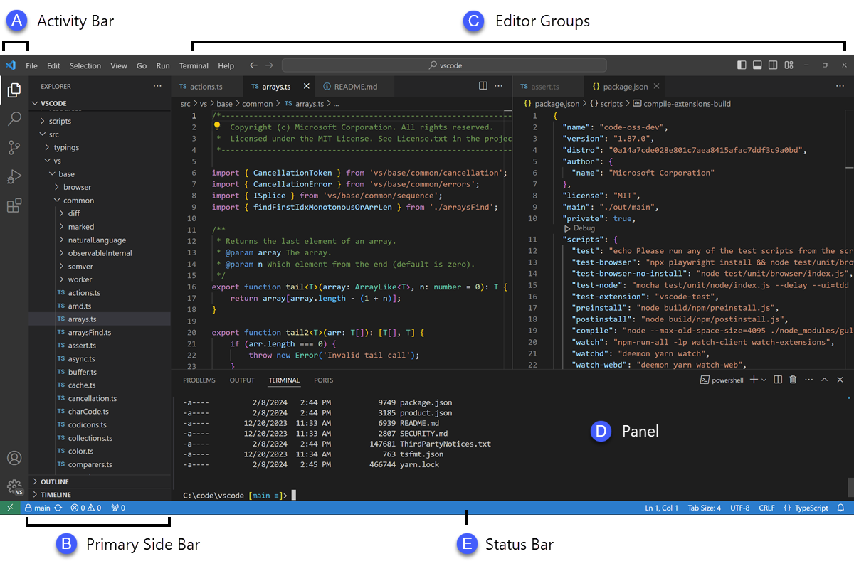
Sample 1.

Slide 17
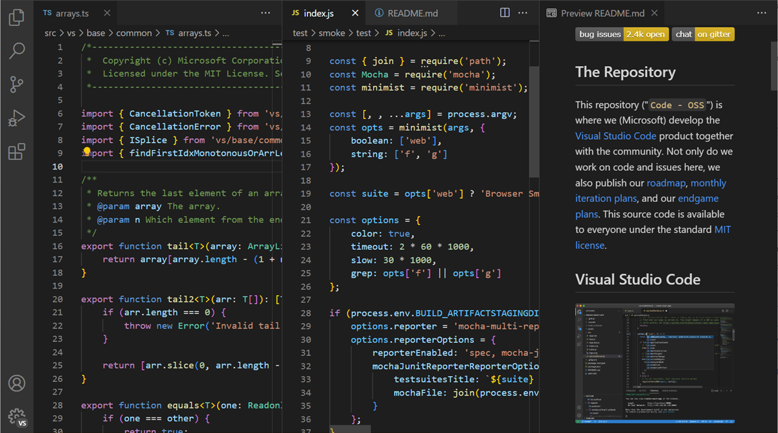
Sample 2.

Slide 18
Step 4.

Slide 19
Command Palette
The Command Palette in Visual Studio Code (VS Code) is a powerful tool that allows you to access various features, commands, and settings directly using keyboard shortcuts or a menu. To open it, use the keyboard shortcut Ctrl+Shift+P (Windows/Linux) or Cmd+Shift+P (Mac). Once opened, start typing to search for a specific command by its name¹².
Here are some common tasks you can perform using the Command Palette:
Change Language Mode: Search for “Change Language Mode” to switch the language mode for the current file.
Install Extensions: Type “Install Extensions” to quickly find and install VS Code extensions.
Run Tasks: Search for “Run Task” to execute predefined build or test tasks.
Toggle Features: Use “Toggle” followed by the feature name (e.g., “Toggle Word Wrap”) to enable or disable specific editor features.
Change Themes: Search for “Color Theme” to switch between different color themes.
Configure Settings: Type “Preferences: Open Settings” to access VS Code settings and customize your environment.

Slide 20
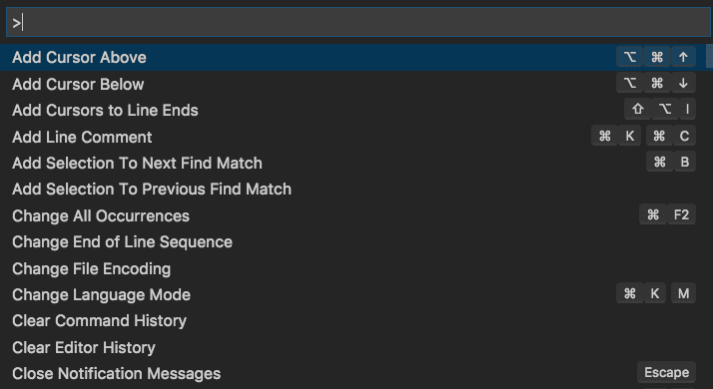
Command Palette

Slide 21
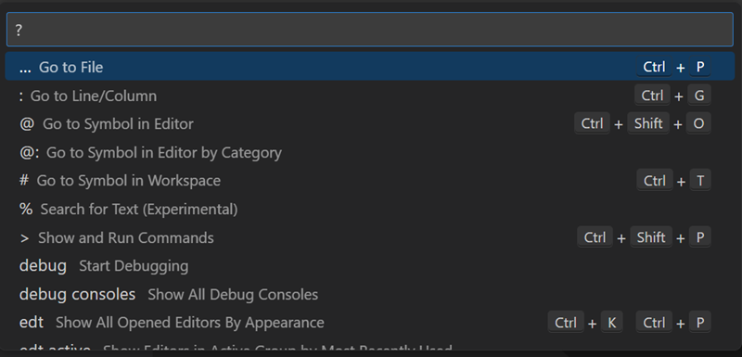
Type ? in the input field to get a list of available commands that you can run from the Command Palette.

Slide 22
Step 5

Slide 23
Essential Extensions for Web Development:
Finding Extensions:
Open VS Code and click on the Extensions icon in the Activity Bar (or use the shortcut Ctrl+Shift+X on Windows/Linux or Cmd+Shift+X on Mac).
Search for extensions by typing keywords (e.g., “JavaScript,” “CSS,” “REST Client”) in the search box.
Browse the results and select an extension to learn more about it.
Installing Extensions:
Once you’ve found an extension, click the “Install” button.
After installation, the button will change to a “Manage” gear icon.
For example, the “TODO Highlight” extension highlights text like “TODO:” and “FIXME:” in your code, making it easier to find undone sections¹.
Essential Extensions for Web Development:
Here are some must-have extensions:
JavaScript (ES6) Code Snippets: Provides code snippets for JavaScript, TypeScript, Vue, React, and HTML, saving you from repetitive typing².
CSS Peek: Allows you to jump directly to CSS code using classes and IDs².
Auto Close Tag: Automatically adds closing tags for HTML and XML².
REST Client: Test APIs and view responses directly within VS Code².
ESLint: Linting utility for JavaScript, helping you catch common errors while coding

Slide 24
STEP 6.

Slide 25
Integrated Terminal:
The integrated terminal in Visual Studio Code (VS Code) is a powerful feature that allows you to run commands and scripts directly within the IDE. Here’s how to use it:
Opening the Integrated Terminal:
Use the keyboard shortcut Ctrl+`` (Windows/Linux) or Cmd+`` (Mac) to toggle the terminal panel.
To create a new terminal, press Ctrl+Shift+`` (Windows/Linux) or Cmd+Shift+`` (Mac)¹.
Advantages of the Integrated Terminal:
Seamless Integration: It starts at the root of your workspace, providing context-aware features like links and error detection.
Multiple Instances: You can manage multiple terminal instances simultaneously.
Shell Integration: Tracks where commands are run, with decorations on the left and in the scrollbar.
Customizable Profiles: Choose from various shells (e.g., Bash, PowerShell) and customize profiles

Slide 26
STEP 7.

Slide 27
File & Folder Management
Visual Studio Code (VS Code) is file and folder based, and you can get started by opening a file or folder directly. Here’s how to manage files and folders:
Opening a Folder:
To open a folder in VS Code, use the File > Open Folder… menu.
Alternatively, if you launch VS Code from a terminal, pass the folder path as the first argument to the code command (e.g., code . opens the current folder).
Explorer View:
Once you open a folder, its contents appear in the Explorer view.
From here, you can create, delete, and rename files and folders.
Use drag and drop to move files and folders around.
Workspace Concepts:
A workspace in VS Code is a collection of one or more folders opened together.
It allows you to configure settings, tasks, and debugger launch configurations specific to that workspace.
You can have single-folder workspaces or multi-root workspaces (with multiple folders).
Single-Folder Workspaces:
When you open a folder, VS Code automatically tracks configuration and editor layout.
Reopening the folder restores your previous state.
Multi-Root Workspaces:
Advanced feature: Configure distinct folders as part of the same workspace.
Use a .code-workspace JSON file to list all folders (e.g., { "folders": [ { "path": "folder-a" }, { "path": "folder-b" } ] }).
Remember, organizing your folders efficiently enhances your productivity in VS Code

Slide 28
STEP 8.

Slide 29
Setting and Preferances
Let’s dive into customizing settings in Visual Studio Code (VS Code):
User and Workspace Settings:
You can configure global settings that apply to all instances of VS Code by navigating to File > Preferences > Settings.
Alternatively, open the Settings editor from the Command Palette (⇧⌘P on Windows/Linux or Ctrl+Shift+P on Mac) with Preferences: Open Settings or use the keyboard shortcut (⌘, on Mac or Ctrl+, on Windows/Linux)¹.
Changing the Theme:
To change the color theme, go to Settings and search for “Color Theme.”
Select your preferred theme from the dropdown list.
Popular themes include “Dark+ (default dark),” “Light+ (default light),” and various community themes².
Adjusting Font Size:
To modify the font size, locate the setting titled “Editor: Font Size” in the User Preferences section.
Click the dropdown arrow and select your desired font size³.
Customizing Keybindings:
Search for “Keybindings” in the Settings editor.
You can create custom keybindings or modify existing ones.
For example, you can remap a specific action to a different key combination¹.
Remember, VS Code is highly customizable, so explore these settings to tailor your development environment to your liking

Slide 30
Step 9.

Slide 31
Debugging in VS Coder
Debugging in Visual Studio Code (VS Code) is essential for identifying and fixing issues in your code. Let’s walk through the steps to set up and start debugging:
Open the Run and Debug View:
Click the Run and Debug icon in the Activity Bar (or use the shortcut ⇧⌘D on Mac or Ctrl+Shift+D on Windows/Linux).
This view displays all information related to running and debugging.
Create a Launch Configuration:
A launch configuration specifies how VS Code should run and debug your app.
If you haven’t created one yet, VS Code will prompt you to do so. You can also manually create a launch.json file in the .vscode folder of your workspace.
Example configuration for Node.js:
JSON
{ "version": "0.2.0", "configurations": [ { "type": "node", "request": "launch", "name": "Launch Program", "program": "${workspaceFolder}/app.js" } ] }
AI-generated code. Review and use carefully. More info on FAQ.
Set Breakpoints:
Place breakpoints in your code where you want to pause execution for inspection.
Click the gutter next to the line number to add a breakpoint.
Start Debugging:
Press F5 or click the green play button in the top bar.
VS Code will run your app and pause at breakpoints.
Use the Debug Console to interact with variables and expressions.
Inspect Variables and Call Stack:
While debugging, explore local and global variables in the Variables view.
Check the Call Stack view to see the function call hierarchy.
Step Through Code:
Use the step buttons (Step Over, Step Into, Step Out) to navigate through your code line by line.
Hover over variables to see their values.
Watch Expressions:
Add expressions to the Watch view to monitor specific variables during debugging.
Key features available in VS Code:
Integrated Terminal: Run commands directly within VS Code.
Browser Debugging: Debug web apps using Edge and Chrome¹.
Customizable Keybindings: Set your preferred shortcuts.
Extensions: Install debuggers for various languages and runtimes.

Slide 32
STEP 10.

Slide 33
Using Source Control
Let’s explore how to use Git with Visual Studio Code (VS Code) for version control:
Set Up Git in VS Code:
Ensure you have Git installed on your computer. If not, follow the instructions to install it¹.
Sign into VS Code with your GitHub account (optional but useful for additional features).
Open a Git Repository:
Clone a repository locally:
Use the Git: Clone command in the Command Palette (⇧⌘P or Ctrl+Shift+P).
Authenticate with GitHub if cloning from there.
Select a repository to clone.
Initialize a new local Git repository:
Open an existing or new folder in VS Code.
In the Source Control view, click Initialize Repository.
This creates a new Git repository in the folder.
Making Commits:
Stage changes:
Use the Source Control view to see changes.
Click the “+” icon next to files to stage them.
Commit changes:
Type a commit message above the changes.
Press Ctrl+Enter (macOS: ⌘+Enter) to commit.
You can commit only staged changes or select specific changes to commit.
Pushing Changes to GitHub:
Publish your local repository to GitHub:
Use the Publish to GitHub command in the Source Control view.
Choose a name, description, and privacy settings for the repository.
VS Code pushes your code to the remote repository.

Slide 34
THE END

